Slide 1
Storage
It is a process through which digital data is saved in a storage device
Also referred to as digital storage, storage, storage media, or storage medium
A storage device is any hardware capable of holding information either temporarily or permanently

Slide 2
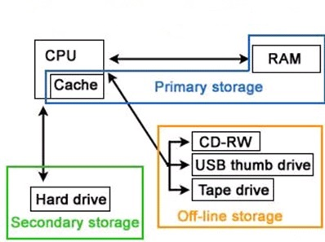
Types of Storage

Slide 3
Storage
Primary Storage
Because the RAM is connected directly to the CPU via the memory bus, the CPU can access data stored in RAM very quickly. For this reason, RAM is used to store data loaded by active program and the operating system.
A cache is a smaller, faster memory, closer to a processor core, which stores copies of the data from frequently used main memory locations.
Hard drives are considered secondary storage since they are not connected directly to the CPU. Instead, hard drives send and receive data through an I/O bus

Slide 4
Storage
Primary Storage
Also known as internal memory, main memory, main storage, and primary memory.
It is the main area in a computer in which data is stored for quick access by the computer's processor.
It is a volatile storage
RAM doesn’t retain data when the computer is turned off because it requires an electrical current.
Random Access Memory (RAM) and cache are examples of a primary storage device.
More faster than Secondary

Slide 5
Types of Storage
Secondary Storage
Also known as external memory or secondary memory
It is a non-volatile device that holds data until it is deleted or overwritten.
Hard drives retain data when the computer is turned off. This is because hard drives store data magnetically.
Hard drive, CD/DVD and Tape drive are examples of a Secondary storage device.

Slide 6
HDD
The hard disk’s primary task is to store data and get out data of the system
Information is stored or retrieved in a random access manner as opposed to sequential access.
The hard drive subsystem (An external disk subsystem connects to a computer through a SAN or NAS) can have up to three parts:
The hard drive
Cables that attach to the motherboard
Control circuits located the motherboard

Slide 7
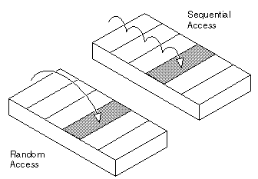
HDD
A random-access data file enables you to read or write information anywhere in the file.
In a sequential-access file, you can only read and write information sequentially,
starting from the beginning of the file.
If you are always accessing information in the same order, a sequential-access file is faster.
If you tend to access information randomly, random access is better.

Slide 8
Component of HDD
Disk Platters - For storing data
Spindle - For spinning the platters
Read/Write Heads - For reading and writing data
Actuator - for controlling the actions of the read/write arm

Slide 9
Disk Platters
It is the circular discs inside the hard drive
Platters are made out of aluminum (desktop), glass (laptop) or ceramic and have a magnetic surface in order to permanently store data.
It can store information on both sides, requiring two heads per platter.
From physical point of view, platter is divided into Magnetic surface, Track, Cylinder and Sector.
Track – Concentric circle on a hard drive platter.
Cylinder – One corresponding track on all surfaces of a hard drive.
Sectors – Each track is divided into sectors of 512 bytes. Newer HDDs use 4096-byte (4 KiB) sectors

Slide 10
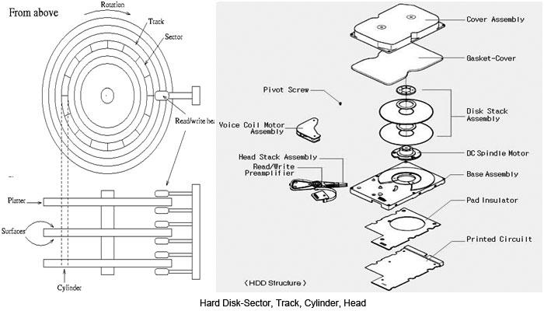
HDD
4 Head x 305 Tracks x 17 Sector x .5Kb = Total Storage capacity 10,370KB

Slide 11
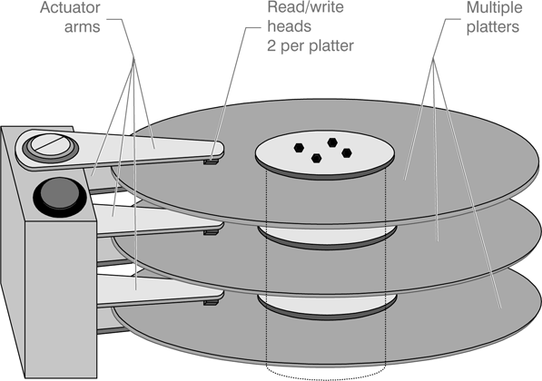
HDD

Slide 12
Spindle
For spinning the platters
The revolutions-per-minute rating determines how fast data can be written to and read from the hard drive.
The rotation rate of the recent popular hard drive is between 5400 revolutions per minute/rpm and 7200 rpm
10000 rpm belongs to high speed hard drive.

Slide 13
Read/Write Heads
The arm make sure that the heads are in the right position based on the data that needs to be accessed or written
There is typically one read/write head for every platter side
It is responsible for transforming the platter's magnetic field into electrical current when read data or vice versa, transform electrical current into magnetic field when write the disk.

Slide 14
Actuator
The actuator or head actuator is a small motor that takes instructions from the drive's circuit board to control the movement of the read/write arm and supervise the transfer of data to and from the platters.
It's responsible for ensuring the read/write heads are in exactly the right place at all times.

Slide 15
Factors affecting disk drive performance
Drive Form Factor
RPM of a Hard Disk Drive (Spindle Speed)
Size and Number of Platter Surfaces
Interfaces

Slide 16
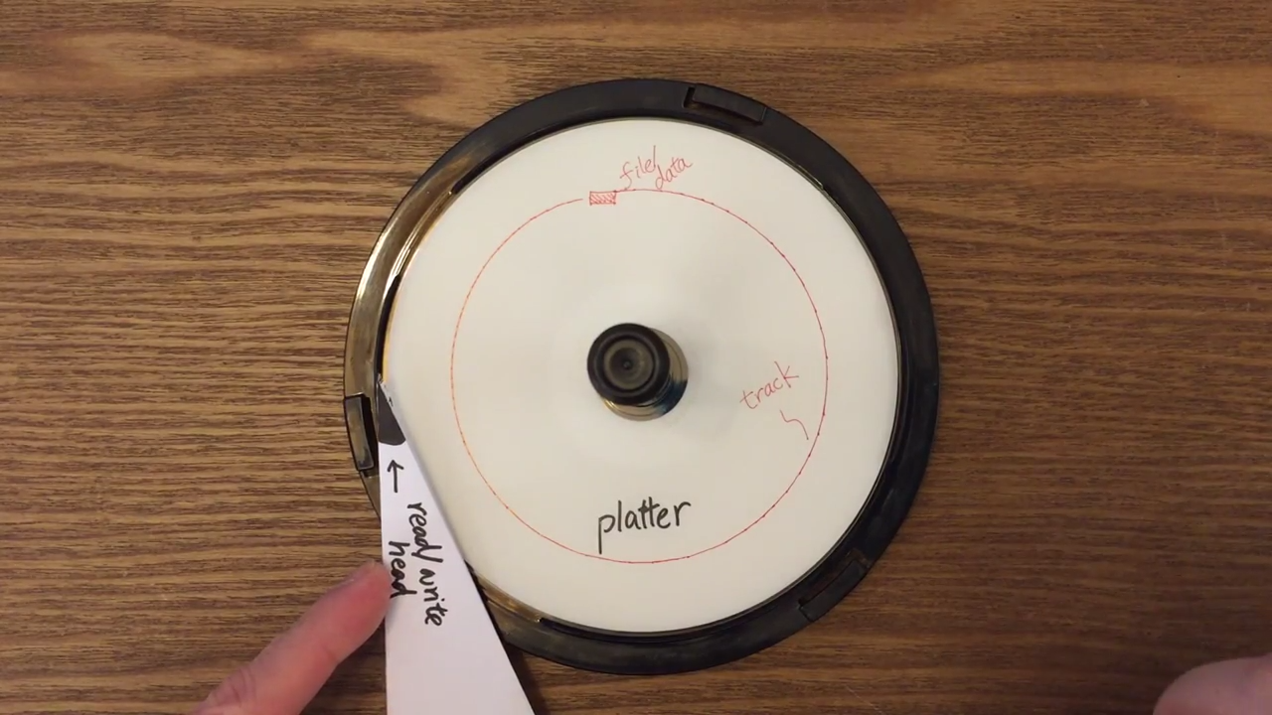
Factors affecting disk drive performance (Access time)
Seek time – Move the head to correct track
Rotational latency - the amount of time it takes for the desired sector of a disk
Access time = Seek time + rotational latency

Slide 17
Solid State Drives (SSD)
It is latest in drive technology that we have in the computer industry.
They do not have moving parts Instead, they make use of flash memory technology.
It is NAND-based flash memory (non-volatile storage)
It comes in a standard 1.8”, 2.5”, or 3.5” size and SATA connector used for these standard sizes.
Faster data access.
Lower access times and latency.
Less power usage.

Slide 18
Hard Disk Drive Interface
The disk interface is the connection of hard disk and host system.
Parallel Advanced Technology Attachment (PATA)
Serial ATA (SATA)
Small Computer System Interface (SCSI)
Serial Attached SCSI (SAS)

Slide 19
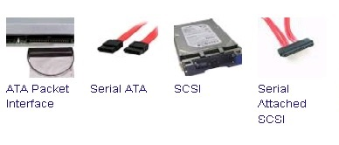
Hard Disk Drive Interface

Slide 20
Parallel Advanced Technology Attachment (PATA)
Sometime it is called IDE (Integrated drive electronic)
It is an interface standard for the connecting hard drives to the motherboard.
It generally refers to the types of cables and connections.
PATA cables are flat cables with 40-pin connectors and it come in 40-wire (black) or 80-wire (black, gray and blue) designs
You may attached two devices to the cable at one time.
It does not support hot swapping so every time you have to shutdown the device before you unplug it.
PATA transfer speeds are 133MB/s
It only allowed to be 18 inches long, which makes it extremely difficult if not impossible to use a PATA device anywhere but inside the computer case.

Slide 21
Serial ATA (SATA)
It is an IDE standard for connecting devices hard drives to the motherboard.
It generally refers to the types of cables and connections.
Serial ATA replaces Parallel ATA as the IDE standard of choice for connecting storage devices inside of a computer.
It support hot swap means that the devices can be replaced without turning off the entire system
SATA transfer speeds are much higher than PATA (from 187.5 MB/s to 1,969 MB/s)
SATA cables can be as long as 1 meter (3.3 feet).
SATA cables are long, 7-pin cables.

Slide 22

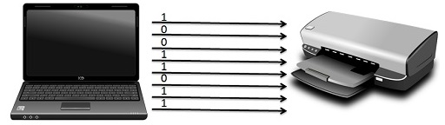
Difference Between Serial and Parallel Transmission
Serial Transmission/Communication:
Serial Transmission data is sent bit by bit whereas, in Parallel Transmission a byte (8 bits) or character is sent.

Slide 23
Serial Transmission
Data is sent bit by bit from one computer to another in bi-direction.
Eight bits are transferred at a time having a start and stop bit (usually known as a Parity bit) i.e. 0 and 1 respectively.
Serial Transmission is full duplex as the sender can send as well as receive.
Serial Transmission has two subclasses synchronous and asynchronous.
In asynchronous transmission, an extra bit is added to each byte so that the receiver is alert about the arrival of new data. Usually, 0 is a start bit, and 1 is the stop bit.
In synchronous transmission, no extra bit is added rather the data transferred in the form of frames which contains multiple bytes.
Serial transmission used for long distance communication

Slide 24
Parallel Transmission
Parallel Transmission, various bits are sent together simultaneously.
There are usually several extra wires on the port that are used for control signals to indicate when data is ready to be sent or received.
Serial Transmission is half duplex as the sender can send but not received simultaneously.
Parallel transmission used for shorter distance communication

Slide 25
Which is Faster
Parallel or Serial
Parallel ports suffer extremely from inter-symbol interference (ISI) and noise, and therefore the data can be corrupted over long distances.
Less noise in the channel means we can successfully transmit data reliably
Both Serial and Parallel Transmission have their advantages and disadvantages respectively.
Parallel Transmission is used for shorter distance, provides greater speed.
On the other hand, Serial Transmission is reliable for transferring data to longer distance.
Hence, we conclude that both serial and parallel are individually essential for transferring data.

Slide 26
Small Computer System Interface (SCSI)
Used to connect different types of hardware devices directly to a motherboard
It generally refers to the types of cables and ports used to connect certain types of hard drives, optical drives, scanners, and other peripheral devices to a computer.
They are faster, very reliable, good for 24/7 operations and Well-adapted for storing and moving large amounts of data.
It uses the 50 pin interface and the appearance of the interface is similar to the general hard disk
Transfer rate for SCSI devices up to 640 MB per second
Rotational speed of the platter, drives usually run at 7,200, 10,000, or 15,000 RPM

Slide 27
Serial Attached SCSI(SAS)
Used in accessing computer peripheral devices that employs a serial (one bit at a time) means of digital data transfer over thin cables.
Serial data transfer allows the use of longer cables than parallel data transfer
Devices that employ SAS are compatible with Serial Advanced Technology Attachment (SATA) devices.
Transfer rate for SAS devices up to 6 gigabits per second

